Slide 1
Introduction to Agile Software Development
COMP 2151 Agile Software Development
Lecture 1

Slide 2
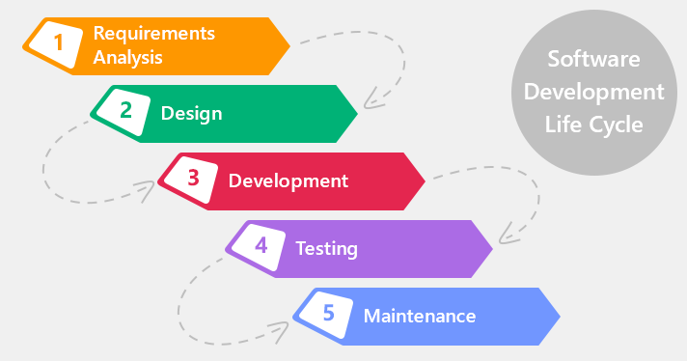
Software Development Life Cycle
Requirements’ elicitation
Design
Development
Testing
Maintenance

Slide 3
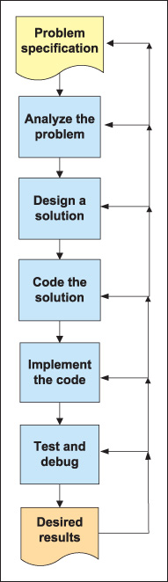
The software development Process:
to divide a software development project into
distinct phases to improve design, product management,
and project management.
Reference
(C# Programming Form Problem Analysis to Program Design by
Barabara Doyle)

Slide 4
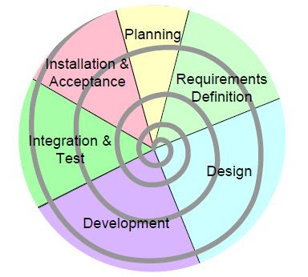
Predictive vs Adaptive approach
Spiral/iterative approach (adaptive)
The Waterfall approach (predictive)

Slide 5
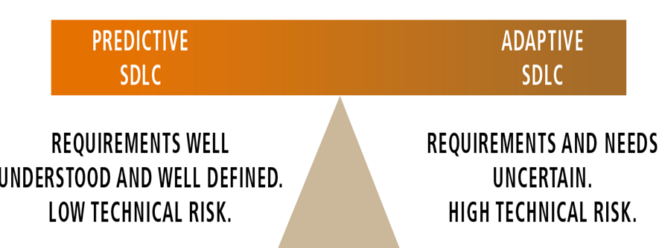
Predictive vs Adaptive approach

Slide 6
Agile Software Development
Various approaches for software development under which requirements and solutions evolve through the collaborative effort of self-organizing and cross-functional teams
and the end users.
It advocates adaptive planning, evolutionary development, early delivery, and continual improvement, and it encourages rapid and flexible response to change
Collier, Ken W. (2011). Agile Analytics: A Value-Driven Approach to Business Intelligence and Data Warehousing
What is Agile Software Development?". Agile Alliance. 8 June 2013. Retrieved 4 April 2015.
Notes:
Discussion
Write down the ideas

Slide 7
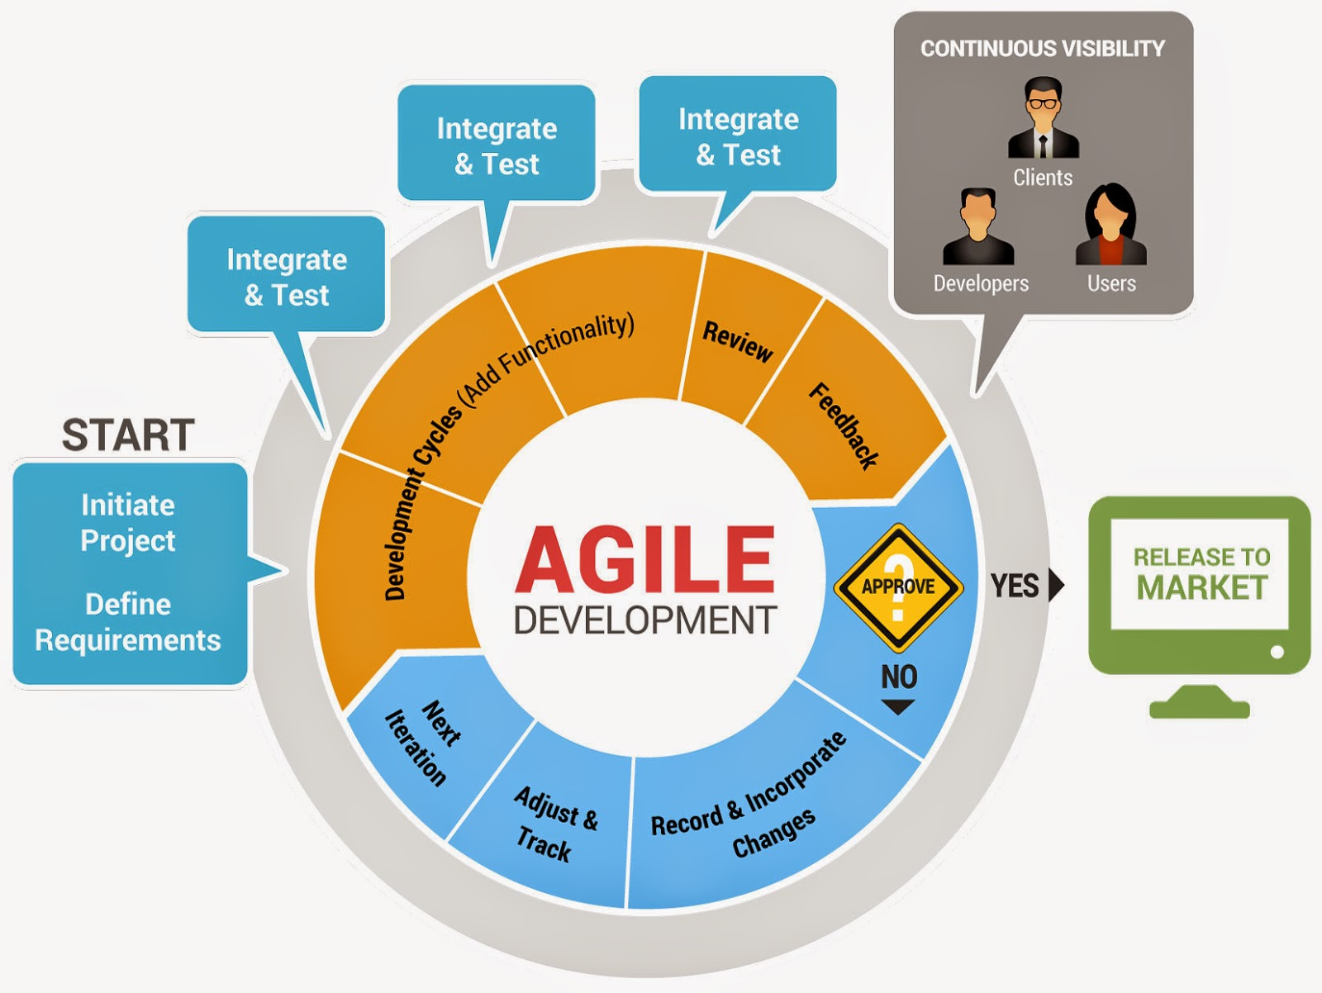

Slide 8
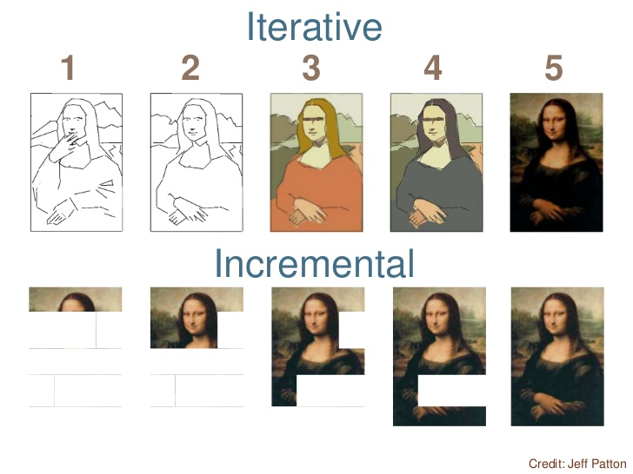
Traditional vs Agile methodology
Ref: https://www.pinterest.ca

Slide 9
About the course
This course introduces the agile development methodologies with an emphasis on SCRUM™ i.e. the most popular agile methodology.
The students would employ SCRUM principles, aspects, and processes for a software development project.
They will acquire the skills of software requirements elicitation and tracking, prototyping, and project management.
Students will also use software design patterns and test-driven development approach for software development.

Slide 10
Course Outcomes
At the end of this course the student will reliably demonstrate the ability to:
Understand the concepts of agile software development and related concepts
Apply agile methods in a small-scale projects
Configure and use version control, task tracking and testing tools
Understand and apply selected design patterns
Manage small-scale project using agile methods

Slide 11
LIST OF TEXTBOOKS AND OTHER TEACHING AIDS:
A Guide to the Scrum Body of Knowledge (https://www.scrumstudy.com/sbokguide)
Scrum: How to Successfully Apply Agile Project Management and Scrum – The Essential Guide (978-1080395002)
Blackboard: https://bb-gbc.blackboard.com (Handouts and other materials provided by the instructor)

Slide 12
Group Project
Implementation of a small-scale project using an Agile process.
Groups of 6 students.
All students must work in groups
Project divided into sprints(phases) and graded accordingly.
Presentation of the project in the last week of the classes.

Slide 13
Failure of IT projects?
A very famous study conducted by Standish group in 1996 reported an alarmingly high failure rate IT Projects :42%
A 2011 study by project management consulting company, PM Solutions reports 37% failure rate.
Project Management Institute (PMI) study in 2016 reports the failure rate at 16%. [cio.com]
Remarkable improvement, Reason AGILE
What is a failure?
Projects are late {Time}
over budget {cost}
fewer features than planned {scope}
The Triple Constraint
Notes:
Discussion
Write down the ideas

Slide 14
Agile Methodologies’ ensures success of IT projects?
“Organizations that embrace agile methodologies and practices for project management are more likely to be successful;
A full 71 percent of organizations report using agile approaches for their projects sometimes or more frequently, the research shows.”
https://www.cio.com/article/3174516/project-management/it-project-success-rates-finally-improving.html
Notes:
Discussion
Write down the ideas

Slide 15
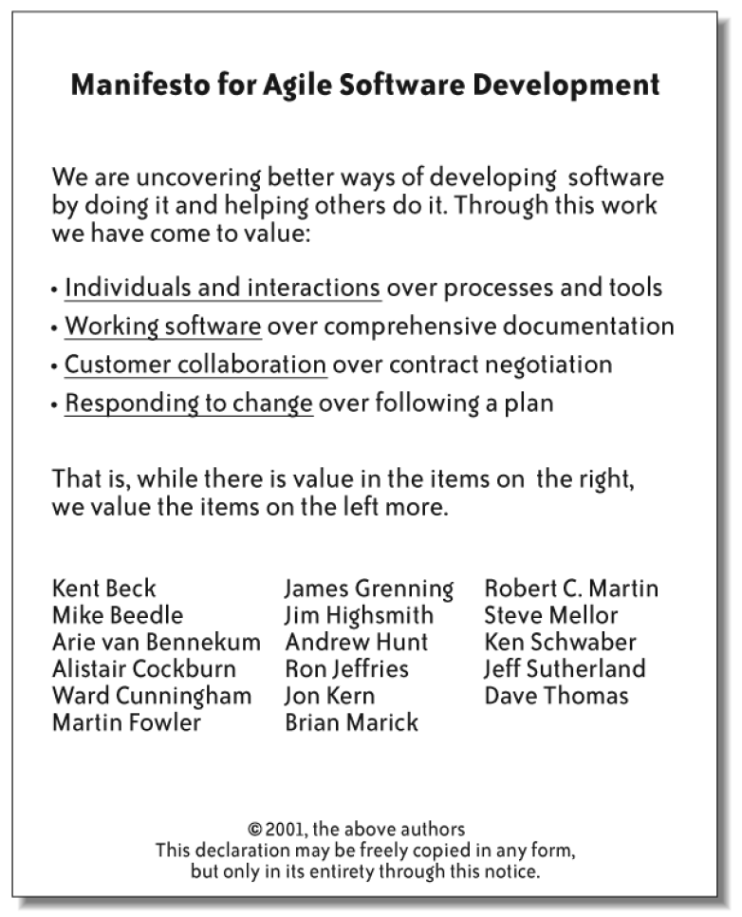
Feb 2001-Seventeen Developers met at a Ski resort in Utah to discuss alternatives to DOCUMENTATION DRIVEN HEAVYWEIGHT software development methodologies.
Result: a Manifesto for Agile Software Development—signed by all participants
This group of seventeen developers named themselves: The Agile Alliance

Slide 16
Agile software development frameworks Two most popular frameworks: SCRUM eXtreme Programming (XP)
Adaptive software development (ASD)
Agile modeling
Agile unified process (AUP)
Disciplined agile deliveryScaled
Agile Framework - SAFe
Feature-driven development (FDD)
Lean software development
Kanban
Rapid application development (RAD)
Scrumban

Slide 17
SCRUM
It is a lightweight process framework for agile development, and the most widely-used one.
A “process framework” is a particular set of practices that must be followed in order for a process to be consistent with the framework.
“Lightweight” means that the overhead of the process is kept as small as possible, to maximize the amount of productive time available for getting useful work done.

Slide 18
History
Hirotaka Takeuchi and Ikujiro Nonaka defined a flexible and all-inclusive product development strategy-in mid 1980’s- where the development team works as a unit to reach a common goal” and called it holistic or “rugby” approach.
In 1995, Ken Schwaber and Jeff Sutherland jointly presented a paper describing the Scrum framework at a Workshop held as part of an IT conference in Austin, Texas (OOPSLA '95).
They were also among the founders of the Agile manifesto (2001).
Scrum Alliance was founded in 2002 and it released the first “Scrum Guide” in 2009. Latest edition came out in November 2020
Scrum.org was founded in 2009.
ScrumStudy.com offer scrum certifications and has compiled the Scrum Body of Knowledge (SBOK) which you can download free by creating an account with them.
https://www.scrumstudy.com/sbokguide/download-free-buy-sbok

Slide 19
Scrum Principles
Empirical Process Control
Self-organization
Collaboration
Value-based Prioritization
Time-boxing
Iterative Development

Slide 20
Scrum Aspects
Organization
Business Justification
Quality
Change
Risk

Slide 21
Scrum Processes
1.Create Project Vision
2. Identify Scrum Master and Stakeholder(s)
3. Form Scrum Team
4. Develop Epic(s)
5. Create Prioritized Product Backlog
6. Conduct Release Planning
9 Plan and Estimate
7. Create User Stories
8. Estimate User Stories
9. Commit User Stories
10. Identify Tasks
11. Estimate Tasks
12. Create Sprint Backlog
10 Implement
13. Create Deliverables
14. Conduct Daily Standup
15. Groom Prioritized Product Backlog
11 Review and Retrospect 16. Demonstrate and Validate Sprint
17. Retrospect SprintRelease
18. Ship Deliverables
19. Retrospect Project

Slide 22
Organization: Scrum Team Roles
Product Owner: representative of the customer.
Development team: consists of three to nine members who carry out all tasks required to build increments of valuable output every sprint.
Scrum Master: is not a traditional team lead or project manager but acts as a “servant-leader” and supports the development team while ensuring that the scrum framework is being followed.

Slide 23
Workflow
Sprint: is a time boxed unit of development in Scrum. (duration between one week and one month, usually two weeks).
Sprint Planning Meeting: held at the beginning of each sprint to discuss and agree on the scope of work that is intended to be done during that sprint.
Daily Scrum: A daily meeting by the scrum team.
Sprint Review: meeting held the end of a sprint review the work accomplished.
Sprint retrospective: meeting held at the end of a sprint to reflects on the past sprint

Slide 24
Scrum Artifacts
The Product backlog: a breakdown of work to be done and contains an ordered list of product requirements in the form of user stories other items are bug fixes, non-functional requirements. The product owner prioritizes product backlog items (PBIs) based on considerations such as risk, business value, dependencies, size, and date needed.
Sprint backlog: is the list of work the development team must finish during the next sprint.
Product Increment: is the potentially releasable output of the sprint and consists of the completed sprint backlog items,

Slide 25
References
Wikipedia
Scrum Study Guide (https://www.scrumstudy.com/sbokguide)
SBOK™
Lessons learned: Using Scrum in non-technical teams". Agile Alliance. Retrieved April 8, 2019.
https://www.scrumalliance.org/about-scrum/overview

